Slide 1
LEAN STARTUP METHODOLOGY
GAURANG-ENG21CT0006
JAICE- ENG21CT0011
SHASHANK -ENG21CT0036
SWAROOP - ENG21CT0041

Slide 2
Agenda
Executive Summary
Scenario evaluation
Our Journey
Field visit-Expert view 1
Field visit- Expert view 2

Slide 3
EXECUTIVE SUMMARY
Change : Implementing a traffic light optimization system using radar, RFID, or microchips for real-time vehicle data collection at traffic signals.
Aspect that will change: Replacing the existing traffic light control system that utilizes IR sensors and cameras with a completely new system based on the chosen technology (radar, RFID, or microchips).
Success or fail metric: Primary metric: No statistically proven matrices is available with us to show significant reduction in average wait time per vehicle across all traffic signals in the test area compared to the existing system using IR sensors and cameras.

Slide 4
SUCCESS/FAIL SCENARIO
Similar Functionality : Existing system likely utilizes IR sensors and AI cameras, achieving similar goals
No need for cost reduction : To manage traffic in cities like Bengaluru, efficiency matters more than cost
Compatibility Issues : Integrating a completely new system with existing traffic light infrastructure could be complex and time-consuming
TCR Priority : The TCR’s (Traffic Control Room) focus might be on maintaining this progress and addressing safety concerns.

Slide 5
Journey
1. Initial Focus: Accident Data Analysis (Karnataka State Police Hackathon)
2. Pivoting to Traffic Optimization Solutions (Manthan Business Idea Hackathon)
3. Refining Ideas through User Interaction
Network engineers Madiwala Traffic Police StationMain Traffic Control Room (Meeting with Dr. Anilkumar)
4. Plan to rephrase the idea .

Slide 6
FIELD VISIT
On Traffic Optimization

Slide 7
EXPERT ADVIDE 1
Date and Time: 22nd March 2024, 12:27
Location : DSU Campus, Kudlu Gate
Name : Yogish M P
Occupation : System Administrator
Perception on idea:
Try to work on drawbacks of current system
Consider preliminary precautions
Alterations:
Work on packet management
Key Findings : RFID ChipsNS3
.

Slide 8
EXPERT ADVIDE 2
Date and Time: 25th March 2024, 01:50
Location : Traffic Control Room, Bengaluru
Name : Dr. Anilkumar P G
Occupation : Traffic Police Inspector
Perception on idea:
Work on road safety rather than optimization
Consider preliminary precautions
Alterations:
Work on road safety
Key Findings:
Current system using IR sensors and Al cameras
ASTRAM

Slide 9
KEY LEARNINGS
Acknowledge the importance of adapting based on user feedback
Emphasize the value of user interaction for refining solutions (e.g., insights from engineers and traffic control room).
Guidance of Prof. Bhaskar Venugopalan sir in decision making and and understanding technical things etc.
Existing Traffic Management System

Slide 10
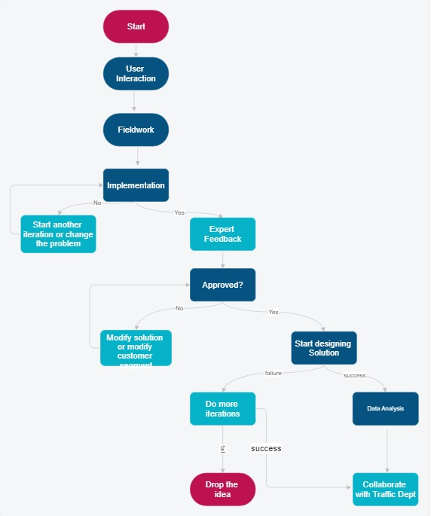
FLOW CHART

Slide 11
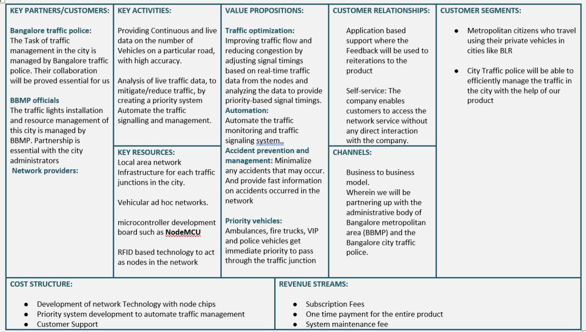
BUSINESS MODEL CANVA 1-TRAFFIC OPTIMIZATION

Slide 12
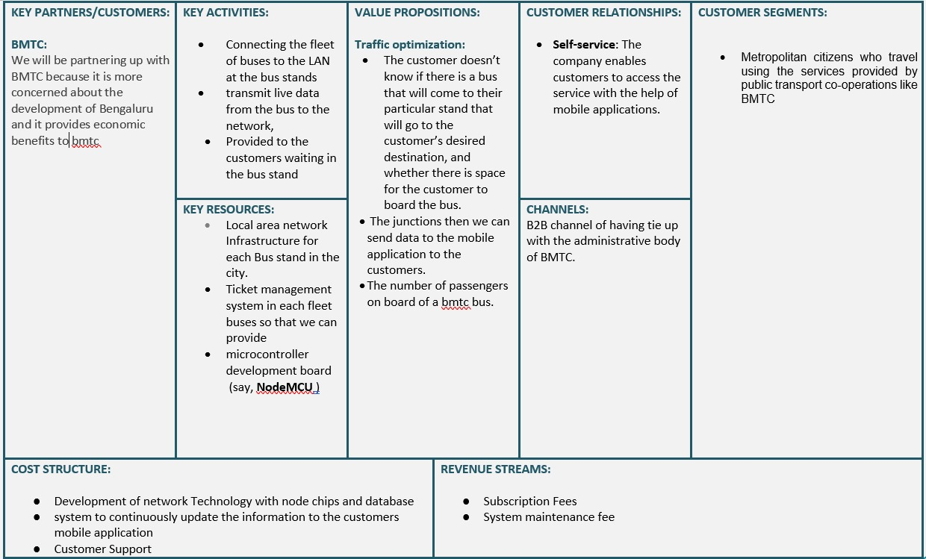
BUSINESS MODEL CANVA 2- PUBLIC TRANSPORT

Slide 13
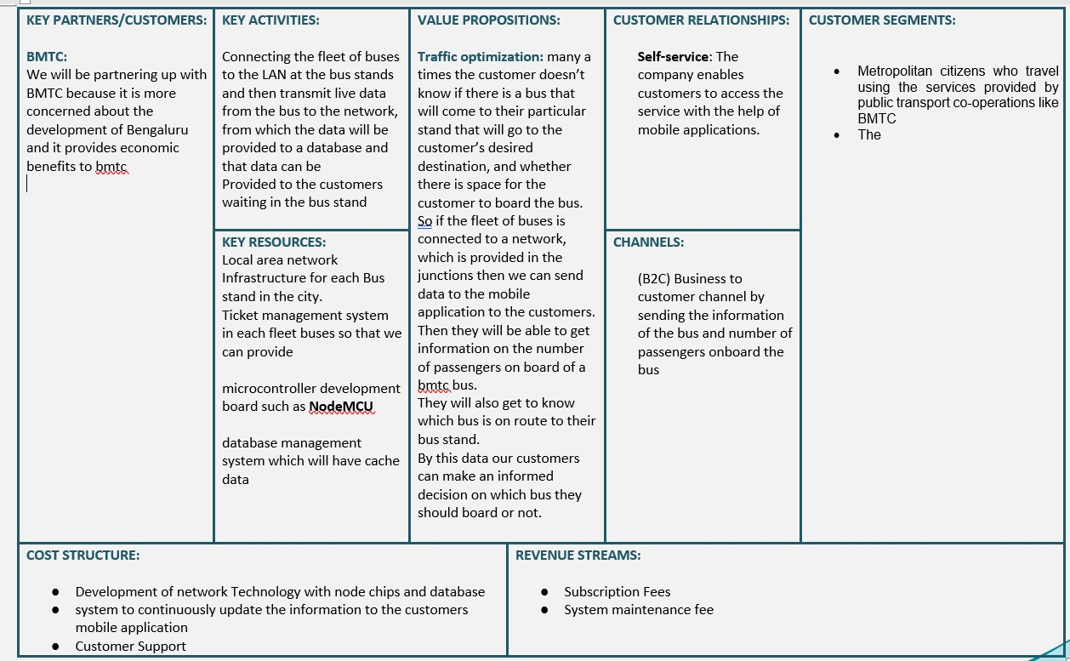
BUSINESS MODEL CANVA 3- PUBLIC TRANSPORT

Slide 14
CONCLUSION
Our traffic light optimization project, while unsuccessful in its initial form, yielded valuable insights. We learned the existing system is already effective. Moving forward, we have two options: partner with the Traffic Control Room to focus on road safety using our real-time data expertise, or explore a new area in traffic management, potentially developing a real-time incident detection system or integrating with navigation apps. Regardless of the path chosen, this project has equipped us with valuable knowledge to make a positive impact on Bengaluru's traffic system.

